Slide 1



Magic of Egypt

Slide 2
TEAM MEMBERS
Yousef Mohamed Reda ( Trip planer page)
Mayar Hany Awad (Home page,Hotel page)
Aya Hasan Mohamed (Contact page)
Doaa Ali Sayed (Home page,Explore Egypt page)
Mohamed Salah Saad Elsabagh (Our Legends)

Slide 3
PROJECR DESCRIPTION
Magic of Egypt is an interactive tourism web platform designed to help users explore Egypt’s most famous destinations in a modern and user-friendly way.
The website provides organized information about cities, landmarks, hotels, and weather conditions, and includes an Interactive Map and a Trip Planner tool that allows users to design their own travel plan.
Built with Angular 19, the project features a clean UI, fast navigation, and a fully responsive design inspired by Egyptian cultural elements.

Slide 4
PROBLEMS
Tourist information in Egypt is scattered and unorganized.
Users struggle to visualize city locations geographically.
Trip planning is time-consuming and confusing.
Choosing suitable hotels requires switching between multiple websites.
Users often need a simple way to communicate or ask questions.

Slide 5
SOLUTIONS
Provide clear, structured, and visual information about each city.
Add an Interactive Map to help users explore locations visually.
Create an easy Trip Planner to build a personalized travel schedule.
Display recommended hotels with prices and ratings in one place.
Include a simple Contact/Feedback page for communication.

Slide 6
MAIN FAETURES
Explore Cities
Hotels Page
Interactive Map
Trip Planner Tool
View major Egyptian destinations
Images + short descriptions
Cultural highlights and attractions
Recommended hotels
Price ranges and user ratings
Easy comparison
Clickable map of Egypt
Shows city information visually
Enhances geographic understanding
Add selected destinations
Arrange them into a day-by-day plan
Supports custom trip structure
Weather Information
Contact & Feedback Page
Displays weather for each city
Helps users plan accordingly
Simple form for inquiries
User-friendly and easy to submit

Slide 7
TOOLS & TECHNOLOGIES
Frontend
Angular 19 – main framework
TypeScript – strong typing & structured development
HTML5 – page structure
CSS3 – styling and responsiveness (Flexbox, Grid)
Bootstrap 5 – optional UI components

Slide 8
TOOLS & TECHNOLOGIES
Angular Core Features
Components
Services & Dependency Injection
Routing Module
Environment Configuration

Slide 9
Developer Responsibility

Slide 10
HOME PAGE
The Home page serves as the main entry point of the Magic of Egypt website.
It introduces users to the platform through a modern and visually engaging layout that includes:
Hero Section: Attractive background image and welcoming message.
Featured Cities: A preview of popular Egyptian cities with quick access to details.
Interactive Map: Allows users to explore locations across Egypt visually.
Weather section: Real-time weather for cities was prepared using a linked API.
Featured Hotels: Highlights recommended hotels with a button to view more.
User Reviews: Shows feedback from travelers to build trust and engagement.
Overall, the Home page provides a clean and intuitive overview of the site, guiding users easily to the main features.

Slide 11
EXPLORE EGYPT PAGE
Problem :
Difficulty Finding Organized Tourism Information
Users usually depend on scattered sources such as blogs, videos, and travel groups to learn about destinations, which consumes time and may not always be reliable.
Solution:
This page displays tourist cities in Egypt on cards. Clicking on a card opens a section for the user showing details about the city and its most famous tourist attractions, along with pictures.

Slide 12
HOTELS / HOTELS DETAILS PAGE
Problem :
Users usually struggle to find reliable and organized hotel information. Details such as prices, ratings, images, and facilities are scattered across many websites.
Even when they find a hotel, they still need to open external pages to view more details or start the booking process, which makes the experience slow and inconvenient.

Slide 13
HOTELS / HOTELS DETAILS PAGE
Solution :
The project includes a complete hotels module that solves this issue by:
Listing all recommended hotels for every city in one page
Showing price range, ratings, and a preview for quick comparison
Providing a Hotel Details Page with full information, images, location, and services
Adding a hotel booking action directly on the details page to simulate the booking process
This creates a smooth, organized, and user-friendly experience that helps travelers choose and book hotels easily without leaving the website.

Slide 14
OUR LEGENDS PAGE
Our Legends page showcases a selection of prominent Egyptian figures who have contributed to shaping Egypt's history, culture, and identity . These figures include ancient pharaohs, scientists, artists, leaders, and modern-day icons.
Each legend is presented as a visual card containing:
A picture of the legend
The legend's name
When a user clicks on a legend card, detailed information and images appear on the page itself, allowing visitors to explore the most important achievements and historical significance in an easy and interactive way.
The page is designed to be simple, engaging, and visually appealing, highlighting Egypt's greatest figures while maintaining a sleek and modern user experience.

Slide 15
PLAN TRIP PAGE
The Trip Planner page allows users to create a personalized travel schedule based on the cities they want to visit.
The user begins by selecting one or more cities, then adds daily entries to build a multi-day travel plan.
For each day, the user can add activities related to the cities they selected.
Once the plan is completed, the user can click the “View My trip” button to preview the full travel itinerary in a separate page.
This page also includes a “Download Plan” button that captures a screenshot of the plan and saves it as an image file directly to the user’s device.
This feature helps users organize their trip efficiently and export their plan in a clear, shareable format.

Slide 16
CONTACT PAGE
The Contact page allows users to send their inquiries, feedback, or messages directly through a simple and clean form.
The form collects the user’s name, email address, and message. Once submitted, the message is sent to a connected email, allowing the project team to receive all communication instantly.
This page ensures easy communication with users and supports quick responses and efficient interaction.

Slide 17
System Architecture

Slide 18
SYSTEM ARCHITECTURE
Angular front-end system using a modular component structure.
AppComponent manages the global layout: Navbar + Footer.
Angular Routing controls navigation between pages without reload.
Each page implemented as a separate component: Home, Cities, Hotels, Trip Planner, Our Legends, Contact.
Reusable UI components used for cards, sections, and layout structure.
Fully responsive design optimized for desktop and mobile.

Slide 19
Design

Slide 20
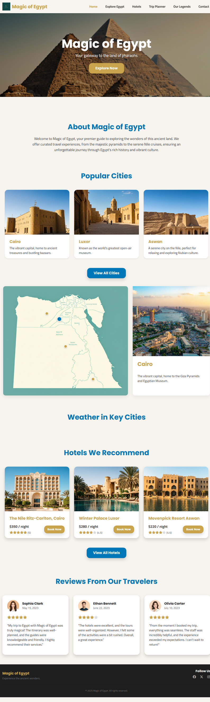
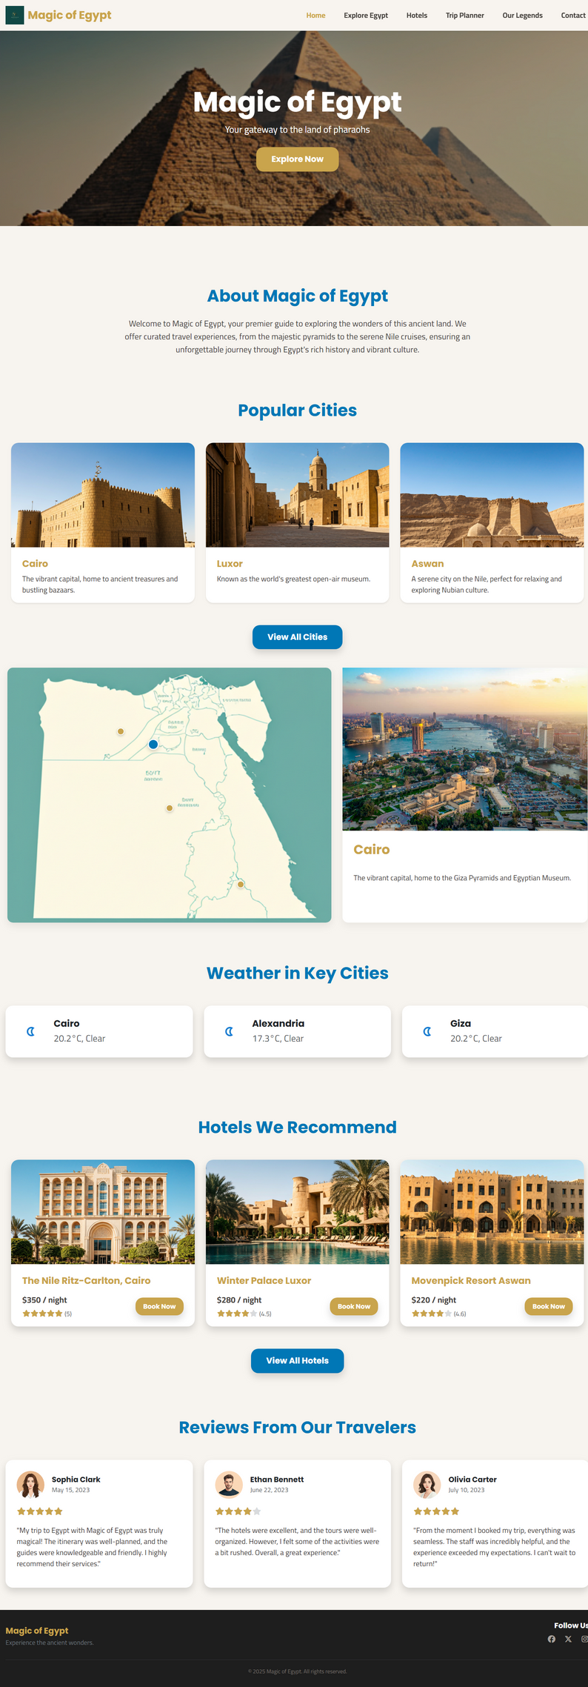
Home Page

Slide 21
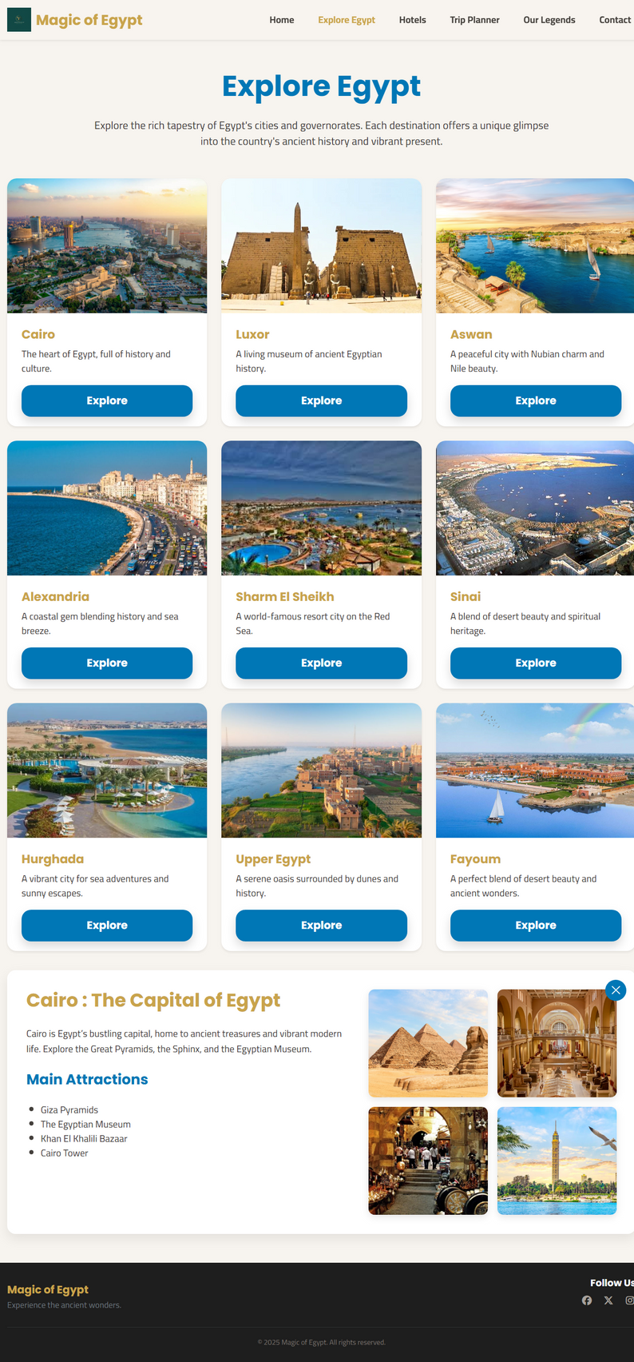
Cities Page

Slide 22
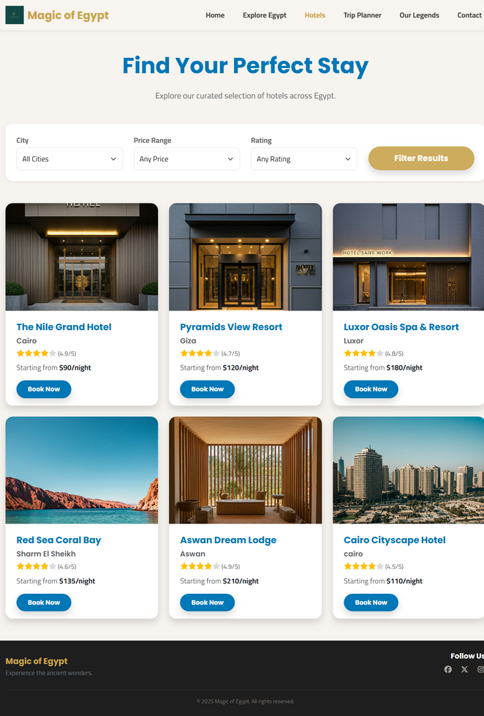
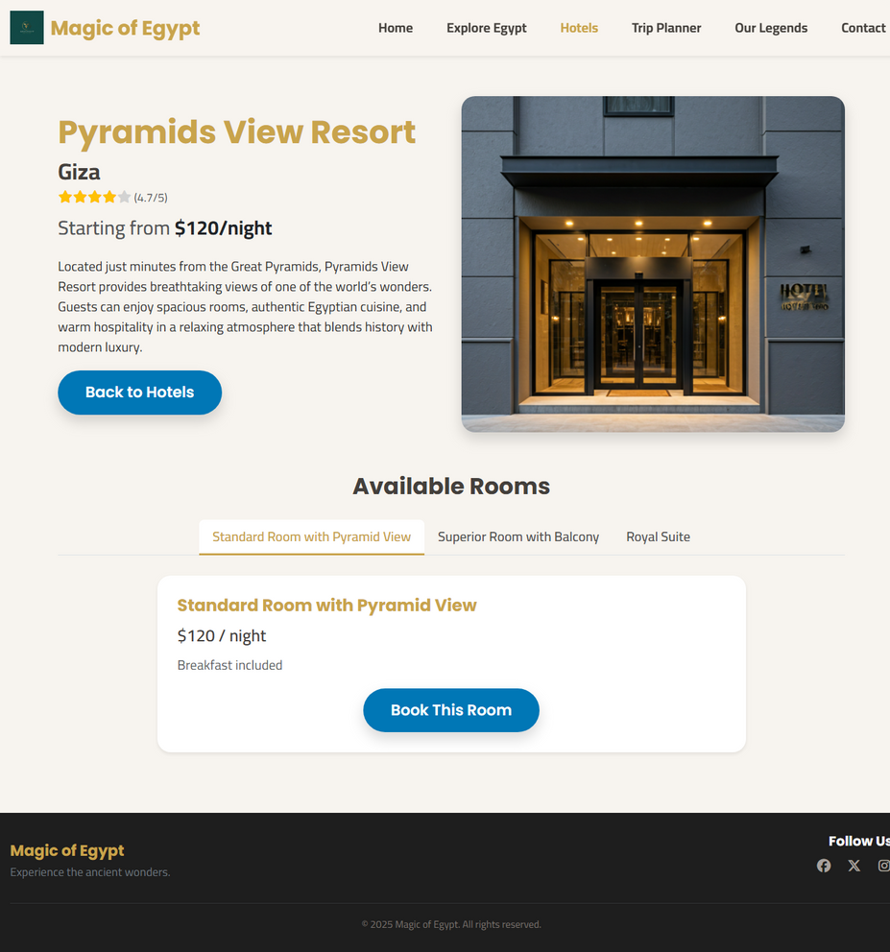
Hotels / Hotel details Page

Slide 23
Thank you!

